Slide 1
MODULE 2: BASELINE ASSESSMENT
Session 5: Market Assessment
Notes:
Market Assessment

Slide 2
What is a market?
A market is a place where goods and services are traded, purchased and sold
Session 5: Market Assessment

Slide 3
Why do we need to know about markets?
In HEA, we need to know about markets because they are the main way poorer households get food, income, and the things they need to live (salt, soap, oil, etc)
Session 5: Market Assessment

Slide 4
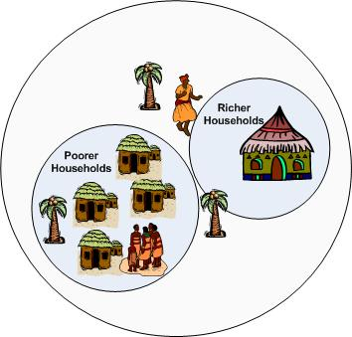


Why do we need to know about markets?
Livestock and grain sold by richer village households to the regional market
Poorer households sell their labour to richer households
Grain sold by regional market to urban market
Clothes, salt and soap sold by traders from urban to regional market
Richer households sell their surplus grain to poorer households
Salt, soap and medicines sold by traders from regional market to village
Session 5: Market Assessment

Slide 5
What do we need to know about markets?
In HEA, what we need to know about markets depends on what step of the framework is being addressed
Session 5: Market Assessment

Slide 6
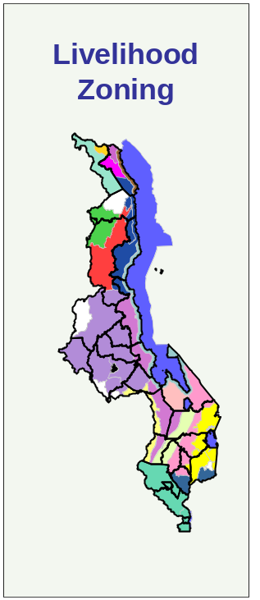
What do we need to know about markets?
Step 1
What we need
to know
Why we need
to know it
Where do people sell their wares (livestock, labour, crops, etc) both within and across the border?
This determines which market changes (prices, closures, etc) will affect their income
Session 5: Market Assessment

Slide 7
What do we need to know about markets?
Step 1
How do we get
the information
Market Mapping
&
Livelihood Zoning Format: markets section
Session 5: Market Assessment

Slide 8
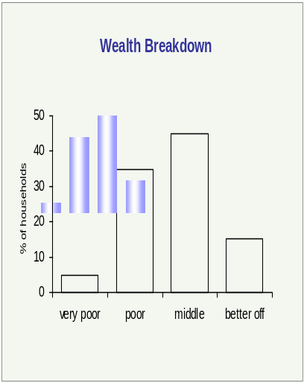
What do we need to know about markets?
Step 2
What we need
to know
Why we need
to know it
How do hhs use exchange relationships within the community to profit or make ends meet?
This tells us who will benefit and who will lose when circumstances or relationships change
Wealth Breakdown
Session 5: Market Assessment

Slide 9
What do we need to know about markets?
Step 2
How do we get
the information
Wealth Breakdown
Interview Form 3
Wealth Breakdown Section
Session 5: Market Assessment

Slide 10
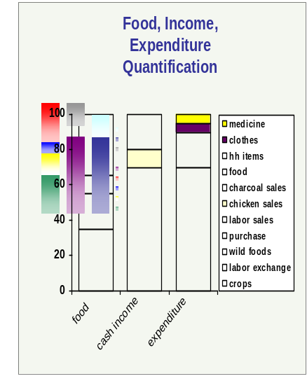
What do we need to know about markets?
Step 3
What we need
to know
Why we need
to know it
Just how much food and cash income do different households obtain through market exchanges?
This tells us which market-related indicators need to be monitored to track changes in livelihoods
Livelihood Strategies
Session 5: Market Assessment

Slide 11
What do we need to know about markets?
Step 3
How do we get
the information
Livelihood Strategies
Interview Form 2
Interview Form 4
Session 5: Market Assessment

Slide 12
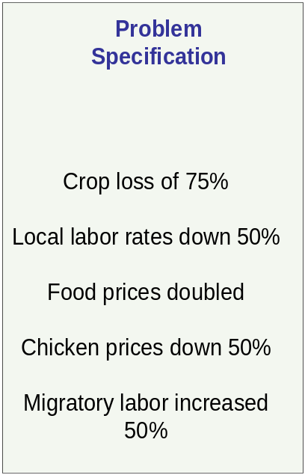
What do we need to know about markets?
Step 4
What we need
to know
Why we need
to know it
Quantifying the shock allows us to calculate its effects on food and cash income and on expenditure.
How much have (or will) prices change? Do people still have physical access to the market?
Session 5: Market Assessment

Slide 13
What do we need to know about markets?
Step 4
How do we get
the information
Interview Form 1
Interview Form 2
Hazards and Timeline Sections
Historical Price Trend Data
Session 5: Market Assessment

Slide 14
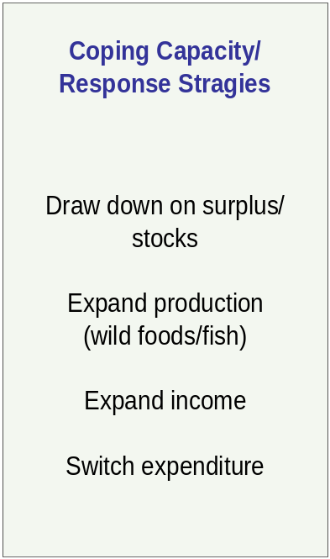
What do we need to know about markets?
Step 5
What we need
to know
Why we need
to know it
This determines the degree to which people will be able to cover a deficit on their own
What opportunities (and limits) does the market present to expand cash income?
Session 5: Market Assessment

Slide 15
What do we need to know about markets?
Step 5
How do we get
the information
Interview Form 3
Bad year section
Analysis of labour and livestock markets
The limits of demand
Session 5: Market Assessment

Slide 16
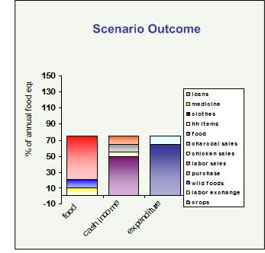
What do we need to know about markets?
Step 6
What we need
to know
Why we need
to know it
Changes in market indicators will determine whether or not people can meet their survival and livelihoods needs
Outcome Analysis
Will prices exceed people’s purchasing power and require an external intervention?
Livelihoods Protection Threshold
Survival Threshold
Session 5: Market Assessment

Slide 17
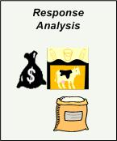
What do we need to know about markets?
Step 6
What we need
to know
Why we need
to know it
All interventions affect markets in one way or another. We want to optimize aid resources while minimizing negative side effects.
How will markets be affected by an intervention?
Session 5: Market Assessment

Slide 18
What do we need to know about markets?
Step 6
How do we get
the information
Market integration studies
Historical price trend analysis
Session 5: Market Assessment

